Slide 1
TSC Developer API Subcommittee
April, 19, 2019

Slide 2
Agenda
Introductions
Scope definition
Engagement Model
API Classes | Workstreams suggestion
Evolving Document on Confluence
Next Steps

Slide 3
Purpose
Contribute towards defining community APIs which are standardized across various network edge stack blueprints

Slide 4
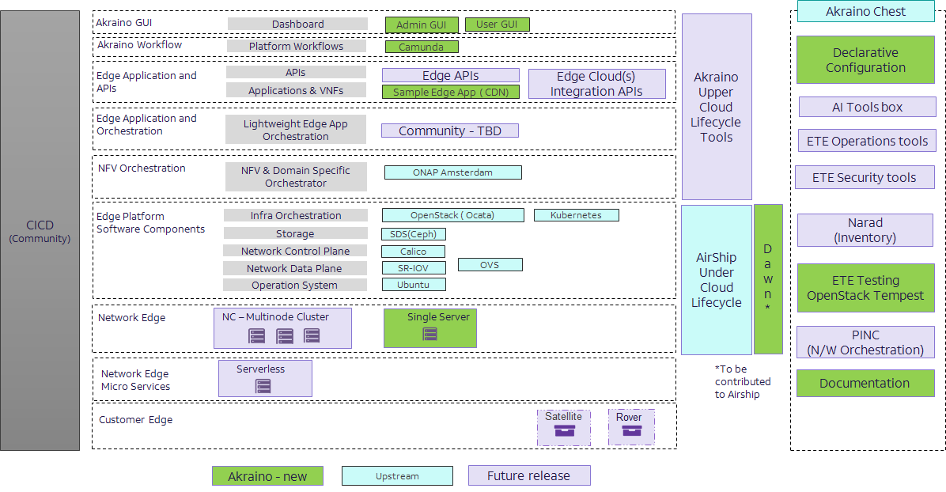
Scope
FOCUS AREA
APP
CLIENT SDK
Orchestration
Virtualization Layer
NOT FOCUS AREA
DATAPLANE
LAYER
HW
LAYER
New application centric
Components

Slide 5
Suggested Engagement Model
Edge vision alignment and scope
Glossary for App Orchestration, Onboarding and Client SDK Terms
API Classes
Technical Discussion and alignment
API Document for LFEDGE/Akraino adoption
Early Collaboration – Shape the Community!

Slide 6
Suggested API Classes
Application Onboarding
Application Deployment
Application Management
Client Side/Device APIs
Application Privacy
Application Scheduling Advanced Features
Early Collaboration – Shape the Community!

Slide 7
Thank You!
Vikram Siwach
vikram.siwach@mobiledgex.com

